Slide 1







Why Middle Years Matter…
in Hume
In a climate of continuous improvement
isolation is the enemy
of improvement

Slide 2
School Lead
Cluster based – best practice
Determine point of need and respond
Responsive to need in the school community – Cool 4 School collaboration between Headspace, HWLLEN, SFYS and Craigieburn feeder schools to Craigieburn Secondary
Parent and Family engagement valued and considered integral to the success of all programs

Slide 3
Capacity Building
Resources that are responsive to the needs in the middle years space
Transition Net
Shared experience and shared learning
Student Voice as part of policy and planning
Capacity Building relevant to issues highlighted by those working in the middle years

Slide 4
Cultural Diversity and Understanding
Access to resources translated into relevant languages pertinent to the middle years
Opportunities for the community to come together
Sense of belonging and Pride in Hume

Slide 5
Individuals can have a massive impact
Informal leaders in our community – who are they and what is the role they play in supporting our young people
Mentors
Experts by “experience”
Importance of relationships with teachers and support staff in schools
Extra-curricular activities and people involved – coaches, team managers, club committees

Slide 6
Local Government Leadership
Important for middle years to be included in its own right in strategy and frameworks as the needs of this cohort come with specific and differing needs to those in ‘the early years’ and equally ‘youth’ more broadly speaking
Opportunity with the current 0-24 Framework consultation to ensure that middle years is included

Slide 7
Issues constantly highlighted in middle years
Transition from primary to secondary
Quality of teaching and learning
Community involvement and engagement

Slide 8
Issues affecting middle years more broadly
Gender equality
Self-harm
Sleep
Cyberbullying
School Pressure
Mental health

Slide 9
Protective factors
Support networks
Physical activity
School belonging
Teacher connectedness
Family interest in the young person

Slide 10
Implications to Hume
Middle years in action plans and frameworks
Local data – use it
Parent and family engagement
Shared practice and action research
Respond to basic needs – accommodation, food security, access to dental and medical treatment
Growing population – are we planning well enough

Slide 11

Relationships Matter

Slide 12
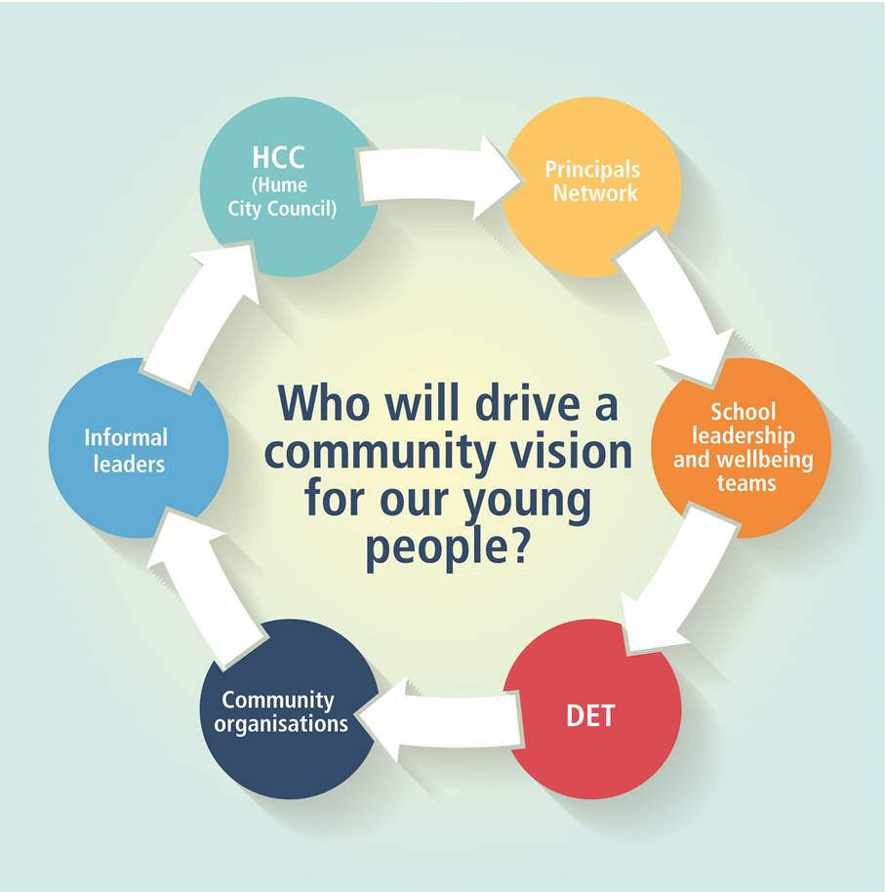
Who will drive a community vision

Slide 13
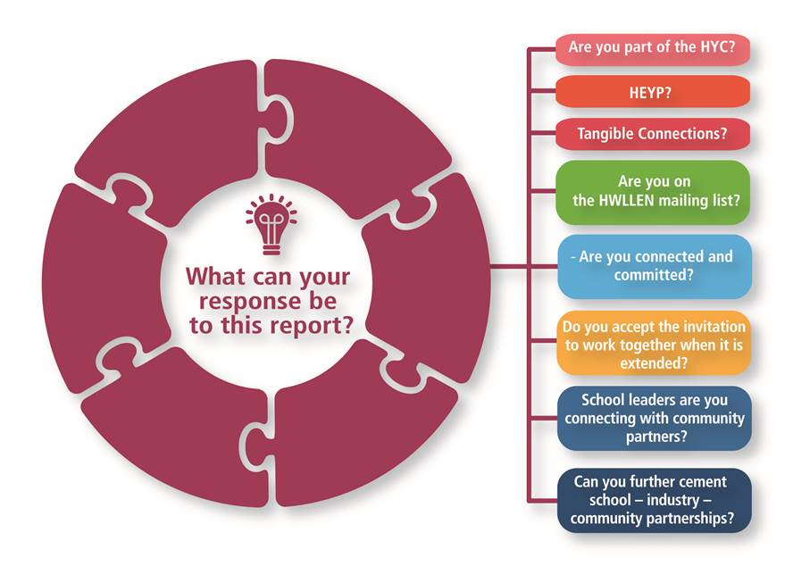
What is your response to this report?

Slide 14
Concerns
DET school Data and disengagement
Violence in schools
Perceptions and attitudes towards refugees
Cultural understanding and capacity to change mindsets
Teacher training and relationship building

Slide 15
DET Data for Hume Government Schools

Slide 16
DET Data for Hume Government Schools
GRADE 5
GRADE 6

